Slide 1

Team 3 «Lucky Seven»

Slide 2
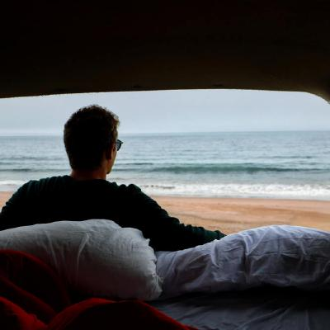
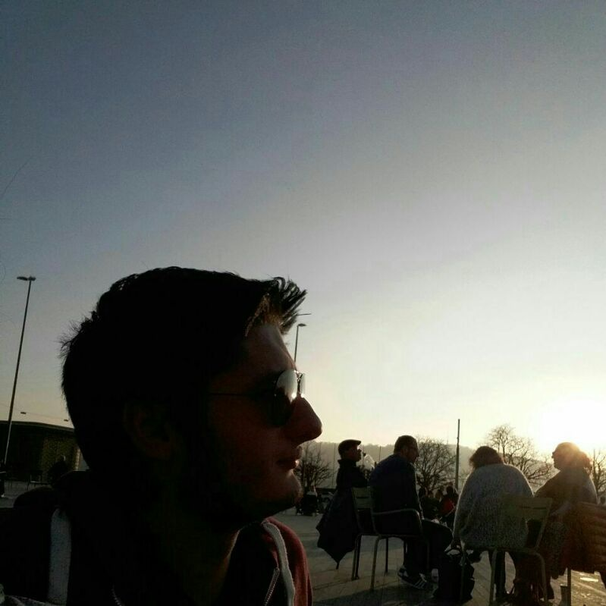
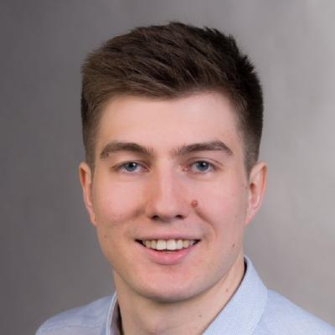
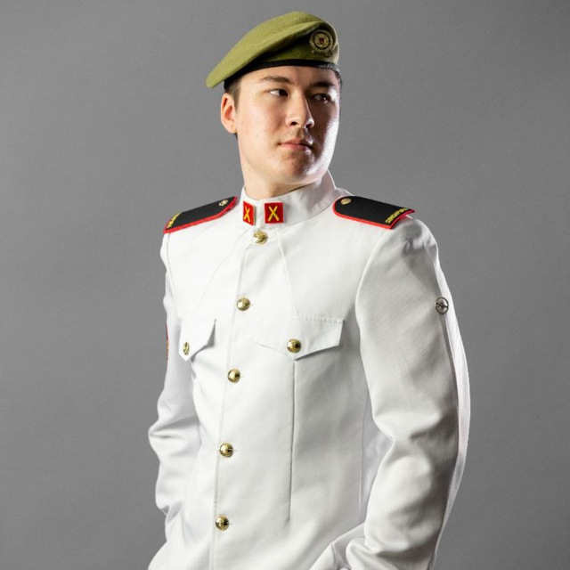
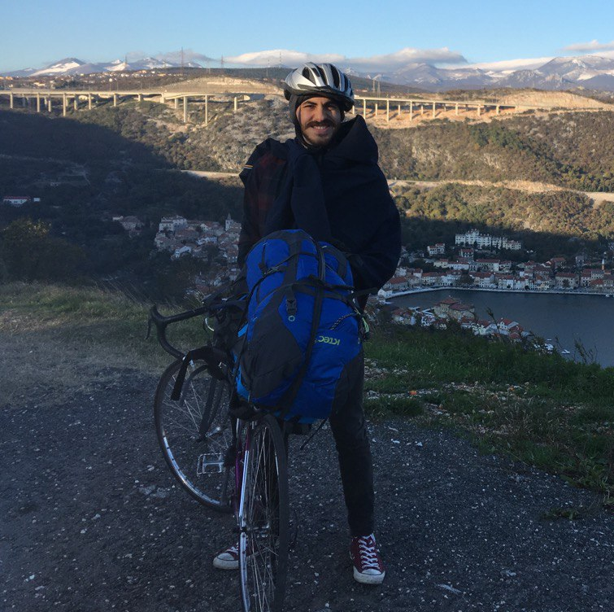
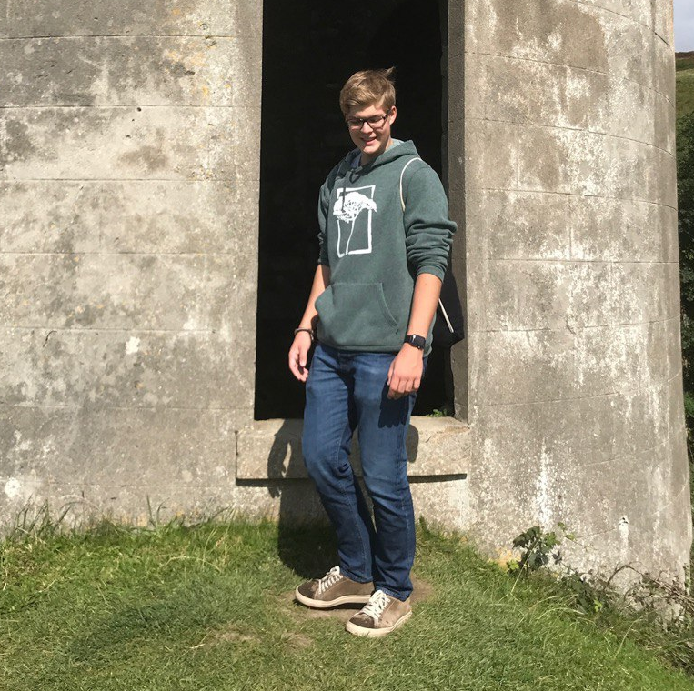
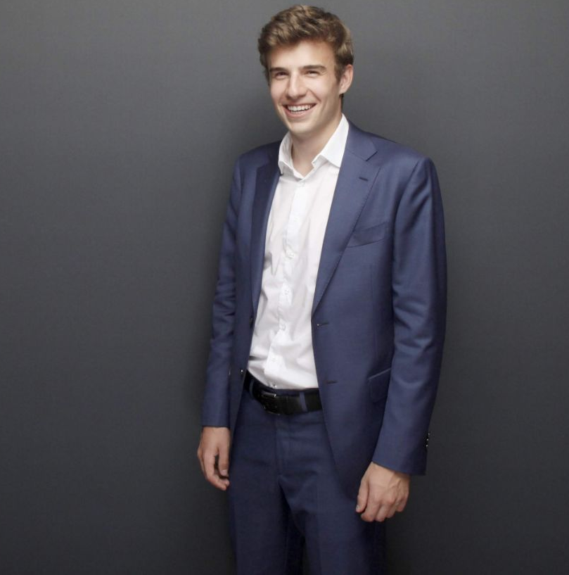
Samuel Stalder
Project Manager
aka Master of Disaster
Erman Zankov
Ressource Manager
aka Skyscraper
Nikita Smailov
Competitive Analysis Specialist
aka The Lucky One
Lukas Zoss
Assistant Project Manager
aka Made in China
Gökhan Bag
Head of Development
aka walking StackOverflow
Tobias Ritscher
Senior Software Engineer specialized in Frantic® Mechanics
aka Diseased Penguin
Joel Plambeck
First Executive Programmer
aka Dätschmeister

Slide 3
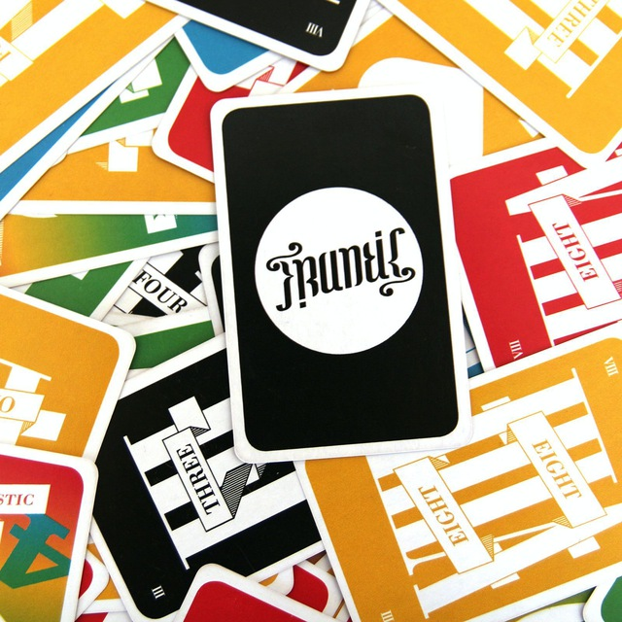
Content
Introduction
Idea
Customer Values
Market Analysis
Main Procedure
Further Requirements
Ressources
Risks
Project Outline
Feasibility
Refrences

Slide 4

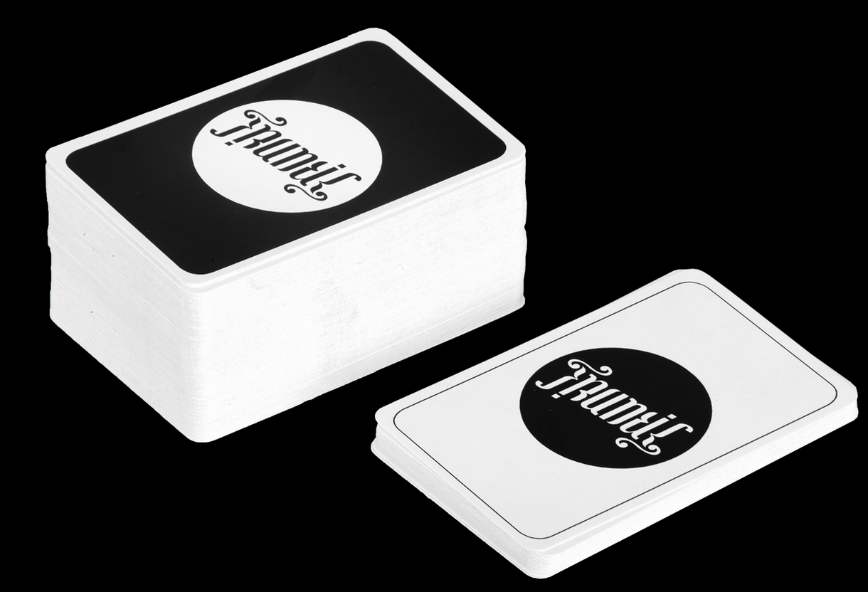


Introduction

Slide 5


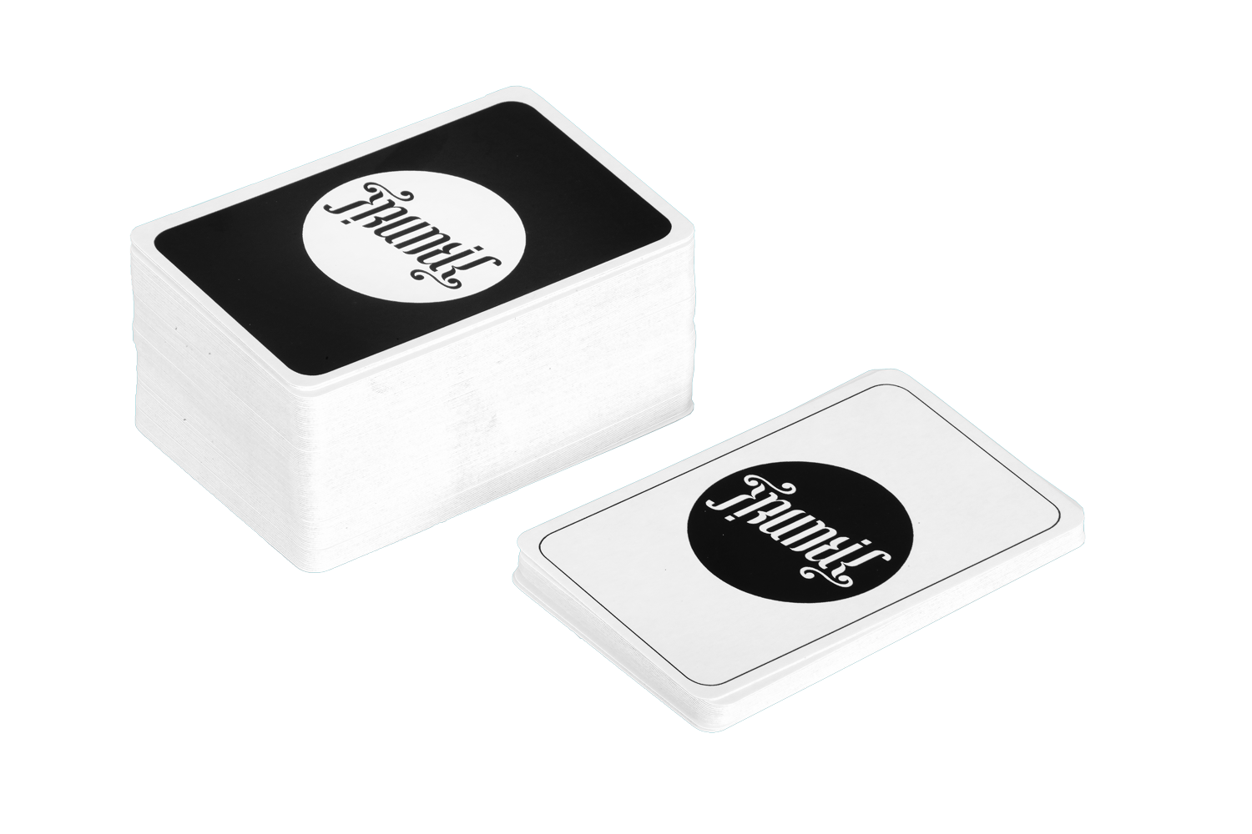
Introduction
Pandemic

Slide 6






Idea

Slide 7












Supported devices
Multiplayer
Unique
Customer
Values
Friends

Slide 8
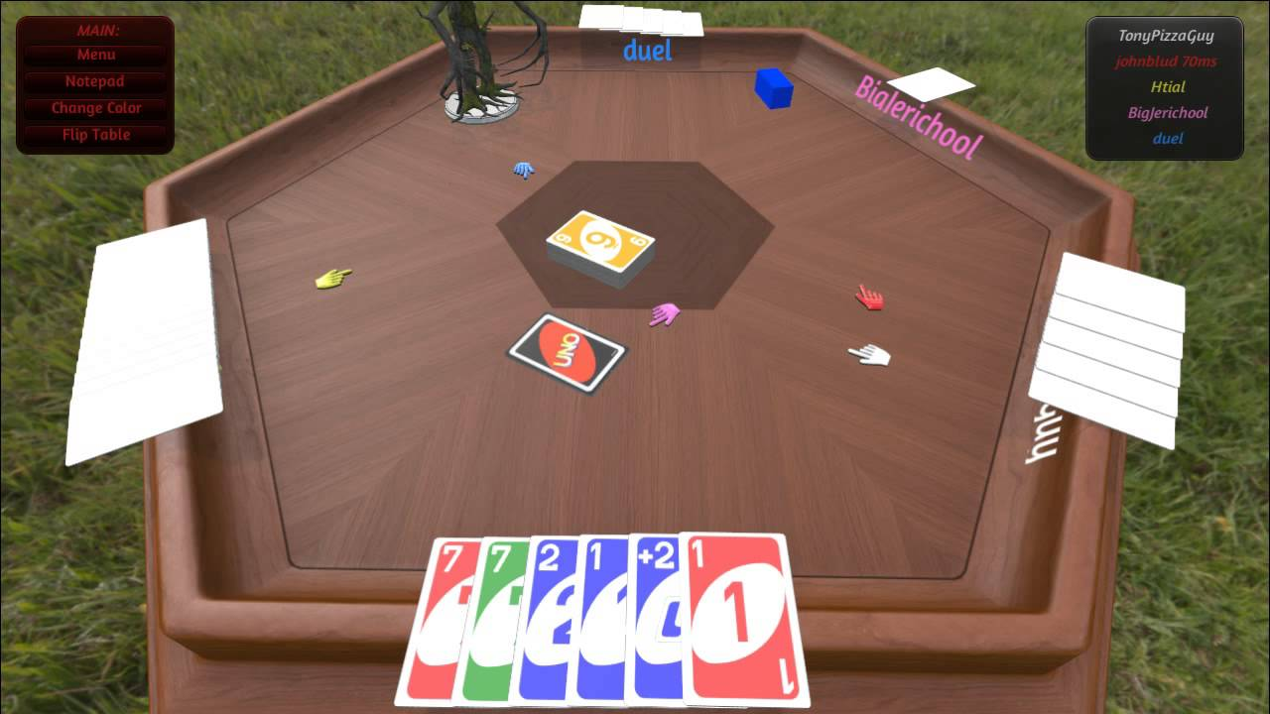
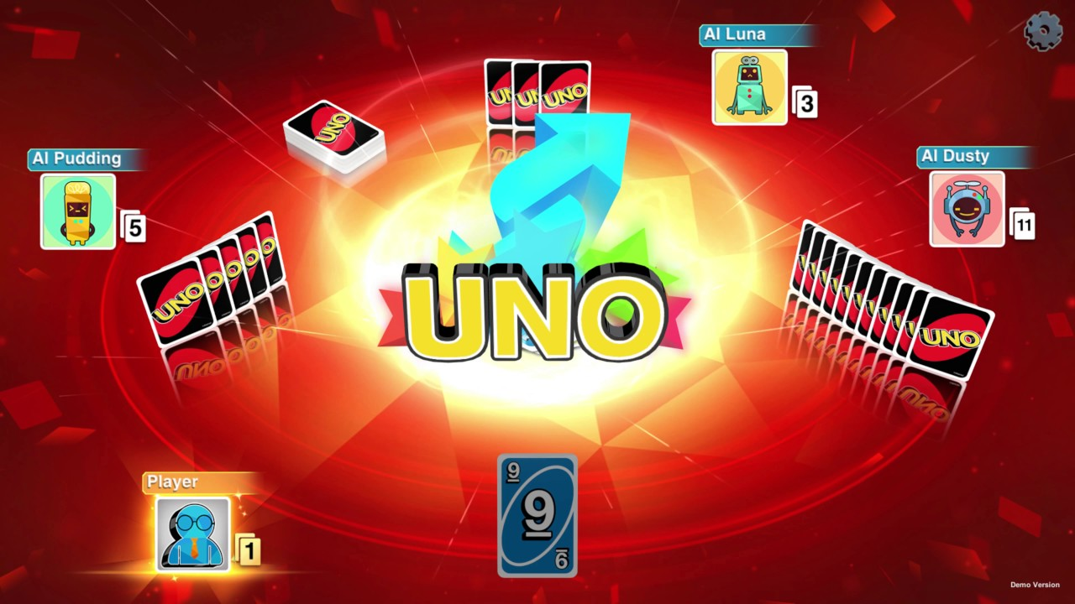
Market Analysis
Tabletop Simulator
Simulator
Several games
UNO
Design
< 4 players
Issues with connection

Slide 9


Main Procedure
Main application

Slide 10




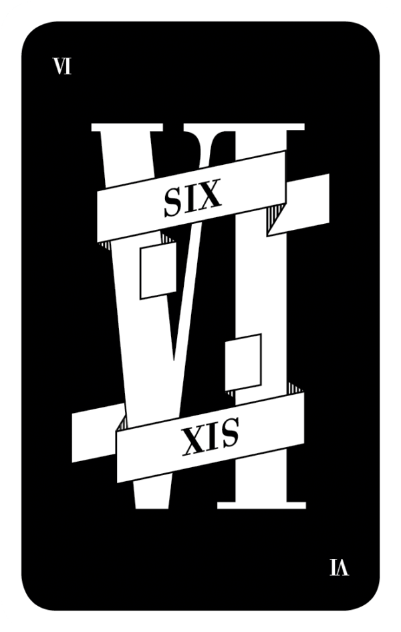



Main Procedure
Main application

Slide 11
Main Procedure
Main application

Slide 12

Main Procedure

Slide 13




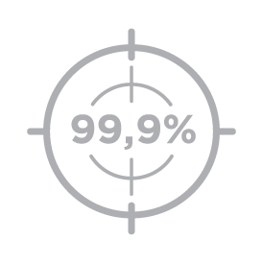
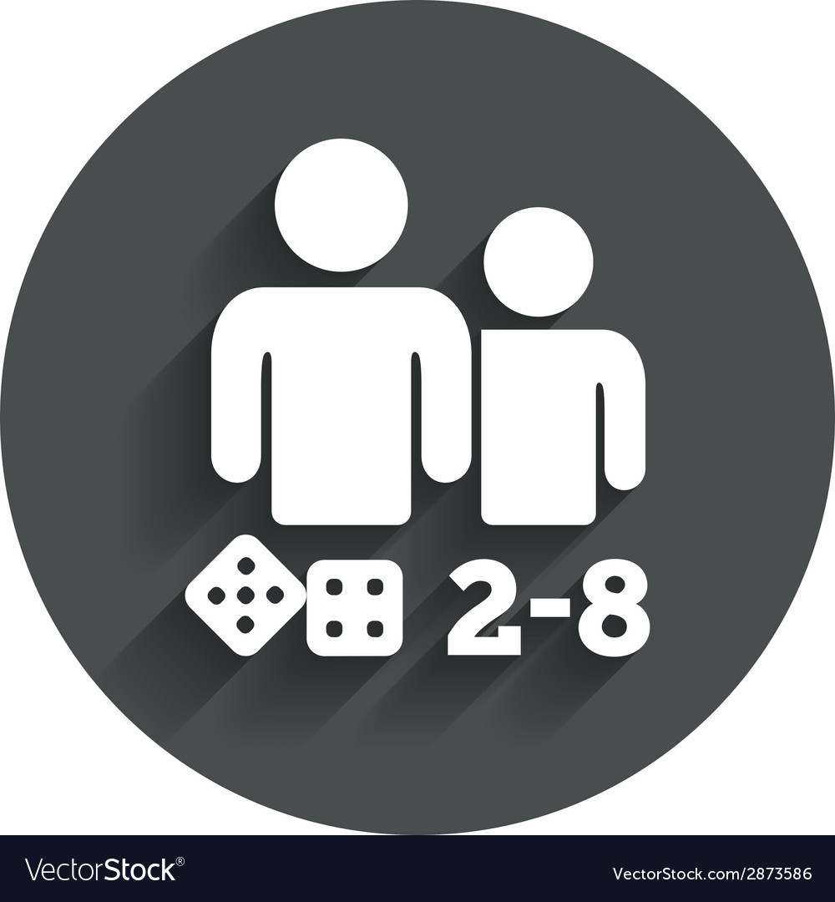
Further Requirements

Slide 14

Resources
Team of 7
Machine Learning and Artificial Intelligence
Servers
10 work weeks

Slide 15

Risks
Machine learning complexity
Server scaling
Data security
Game popularity

Slide 16

Project Outline
M1: Project sketch
M2: Solution architecture, technical report 1
M3: Beta-Release, technical report 2
M4: Stable release
M5: General availability

Slide 17
Feasibility
Description of earnings | Amount in CHF
Product sales (pre-order) | 84’000
Product sales (without pre-order) | 100’000
Merchandising | 5’000
Sponsors | 7’000
Description of expenditures | Amount in CHF
Personnel costs (till beta release) | 84’000
Personnel costs (after beta release) | 84’000
Marketing | 10’000
Events | 5’000
Server costs | 5’000
Infrastructure | 1’000
Description sum | Amount in CHF
Earnings | 196’000
Expenditure | 189’000
profit | 10’000

Slide 18
References
[1] R. F. &. C. KLG, „Rule Factory,“ [Online]. Available: https://rulefactory.ch/en/frantic/ [Accessed Sept. 27, 2020].
[2] S. Rohner, „FM1Today.ch,“ 12 September 2020. [Online]. Available: https://www.fm1today.ch/ostschweiz/stgallen/frantic-hat-auch-schon-wehen-ausgeloest-139092655 [Accessed Sept. 26, 2020].
[3] Welcome to Steam. [Online]. Available: https://store.steampowered.com/?l=english (https://store.steampowered.com/?l=english%22%20%5Ct%20%22_blank) [Accessed Sept. 27, 2020]
[4] Uno on Steam. [Online]. Available: https://store.steampowered.com/app/470220/UNO (https://store.steampowered.com/app/470220/UNO%22%20%5Ct%20%22_blank) [Accessed Sept. 27, 2020]
[5] Tabletop Simulator on Steam. [Online]. Available: https://store.steampowered.com/app/286160/Tabletop_Simulator/ (https://store.steampowered.com/app/286160/Tabletop_Simulator/%22%20%5Ct%20%22_blank) [Accessed Sept. 27, 2020]
[6] UNO® - AT_Ubisoft. [Online]. Available: https://store.ubi.com/at/game?pid=57c19450ef3aa52a768b4567 (https://store.ubi.com/at/game?pid=57c19450ef3aa52a768b4567%22%20%5Ct%20%22_blank). [Accessed Sept. 27, 2020]

